Slide 1
DevSecOps

Slide 2
Objectives
At the end of this session, you will be able to:
    What is DevSecOps
    Importance of DevSecOps
    Difference between DevOps and DevSecOps

Slide 3
Agenda
Different SDLC models
Difference between DevOps and DevSecOps
How we can implement DevSecOps

Slide 4
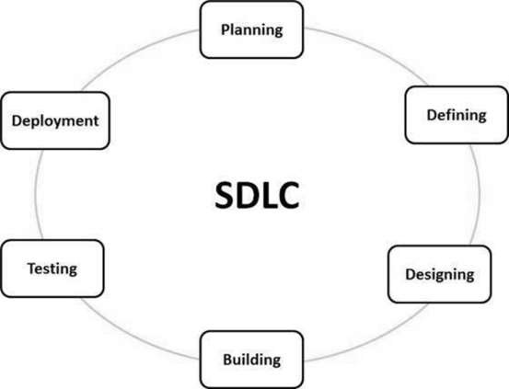
What is SDLC
SDLC is a process followed for a software project, within a software organization.
It consists of a detailed plan describing how to develop, maintain, replace and alter or enhance specific software.
The life cycle defines a methodology for improving the quality of software and the overall development process.

Slide 5
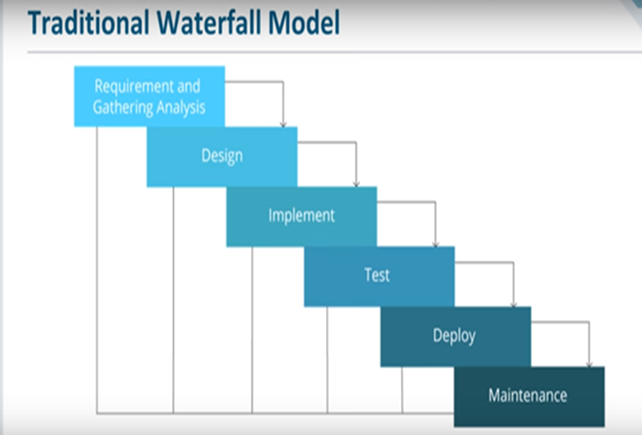
Water Fall Model
Waterfall approach was first SDLC Model to be used widely in Software Engineering to ensure success of the project.
`In "The Waterfall" approach, the whole process of software development is divided into separate phases.
In this Waterfall model, typically, the outcome of one phase acts as the input for the next phase sequentially.

Slide 6
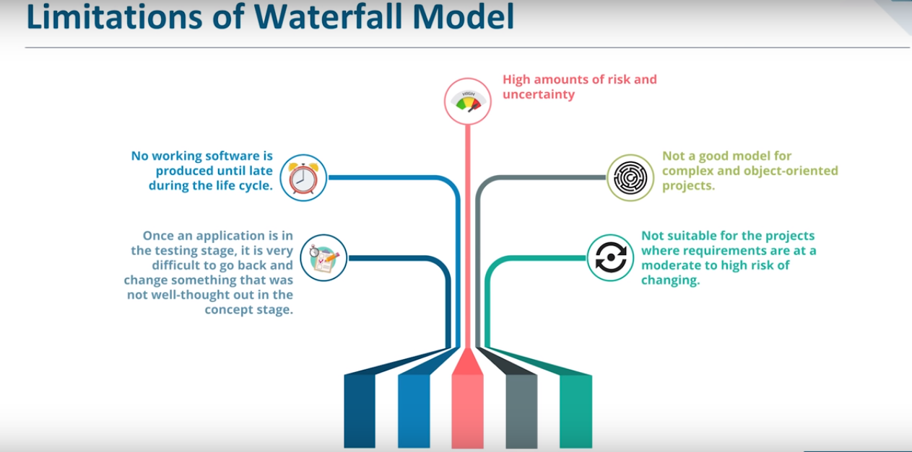

Slide 7
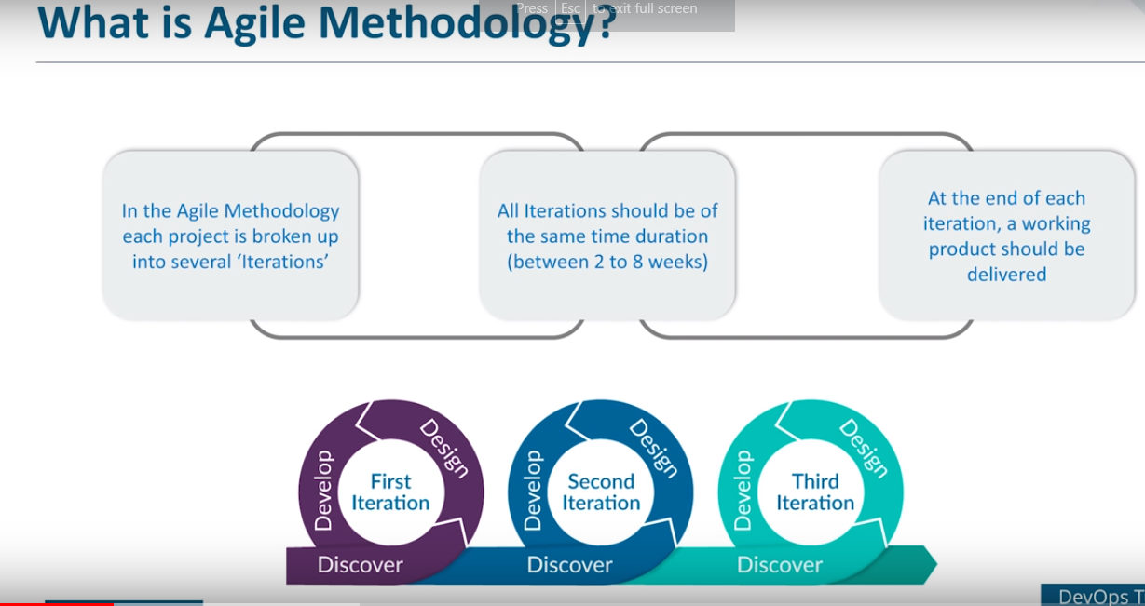

Slide 8
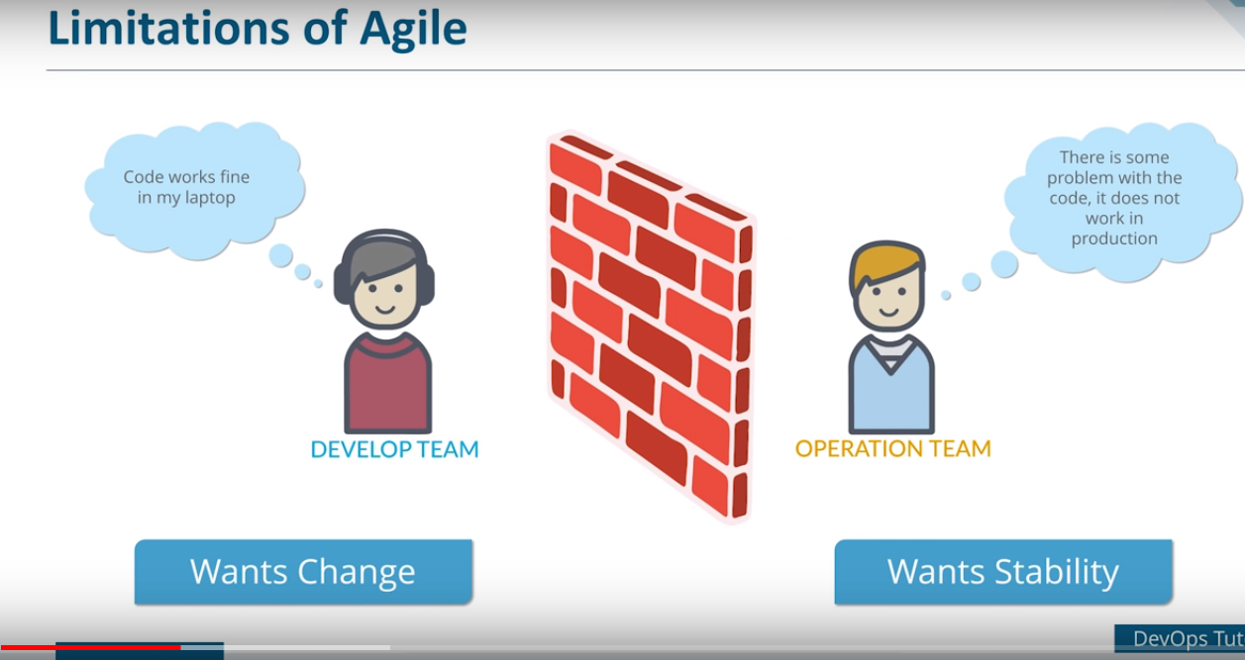

Slide 9
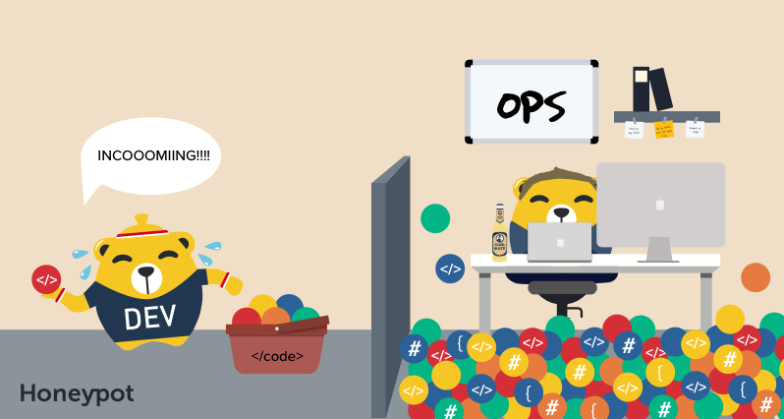
Challenges in Agile

Slide 10
Challenges in Agile
Development and operations team work in isolations
In Agile, Operations team has no clue on the progress of the Development team. So, operations team develops an IT infrastructure deployment and monitoring plan as per their understanding.
Manual code deployment leads to human errors in production
organizations would divide work and communicate internally, but hardly ever between teams. When one team completed their tasks, they would pass it to the next team, throwing it over the proverbial “wall”, assuming that their job was done and they had nothing else to do with the project.

Slide 11
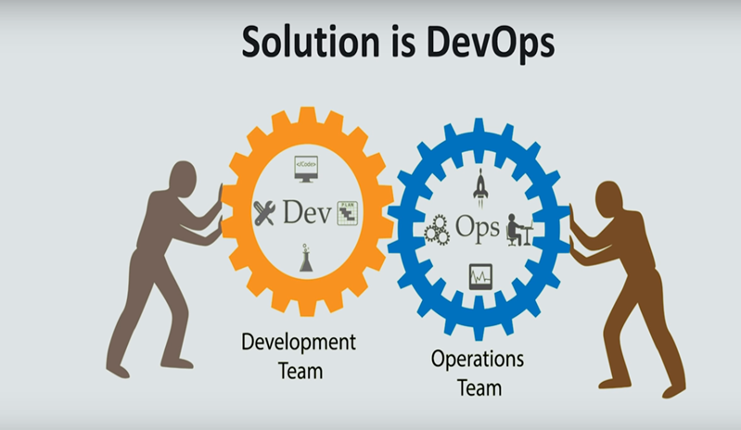

Slide 12
DevOps
DevOps is a culture which promotes collaboration between Development and Operations Team to deploy code to production faster in an automated & repeatable way
Before DevOps operation and Development team working in completed isolation.
Manual code deployment leads to human errors in production
In the Old process, Operations team has no clue on the progress of the Development team. So, operations team developed a IT infrastructure purchase and monitoring plan as per their understanding.
In the DevOps process operation team fully aware of the progress of developer. The purchase and monitoring planning is accurate.
DevOps offers Maintainability, Predictability, Greater quality cost efficiency and time to market.

Slide 13
DevOps ----Continued
Agile process focuses on functional and non-functional readiness while DevOps focuses on that IT infrastructure aspects.
DevOps life cycle includes Development, Testing, Integration, Deployment, and Monitoring.
DevOps lifecycle must be automated to satisfy CI/CD concept .
DevOps helps organizations in shifting their code deployment cycles to weeks and months instead of years.

Slide 14
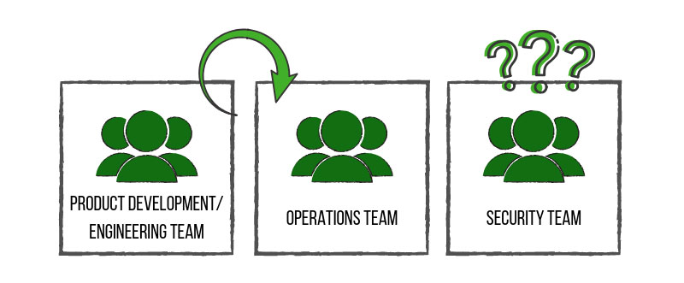
What is DevSecOps?
Before there was DevOps, organizations would divide work and communicate internally, but hardly ever between teams. When one team completed their tasks, they would pass it to the next team, throwing it over the proverbial “wall”, assuming that their job was done and they had nothing else to do with the project.
When the DevOps methodology came about, it revolutionized the way teams worked together, with the goal of getting product and development to talk to operations.
The security team was often clued in at the end of the project, much like an afterthought.
This lack of communication caused confusion and conflict between teams, slowed down production time and introduced more vulnerable products to the consumer. This, of course, consequently affected the path of value for companies.
.

Slide 15
Continued….
DevSecOps is the evolution of the DevOps philosophy.
The advent of DevSecOps placed security into the big picture and allowed all involved teams to work together from development to end product – a stronger, more efficient and more resilient end product.
It is a concept that injects security into the software development lifecycle. If DevOps is about increasing the level of communication between development and operations, then DevSecOps is about inviting security into the conversation
Now with DevSecOps concept of CI/CD/CS come into picture .

Slide 16
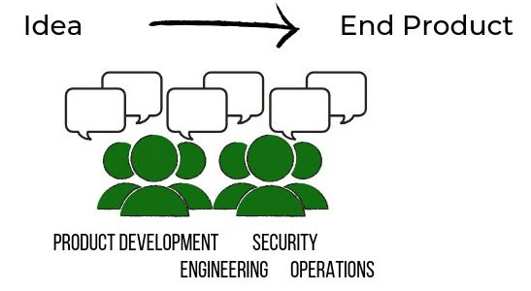
What we want to achieve through DevSecOps?

Slide 17
Tips for Building Secure Software
1. Understand Your User
Before writing a single line of code, you must know the “Why” behind your software. What are your user’s needs? How will they use the end-product? Without a clear vision of your ideal user, it’s hard to create a solid framework. Make sure that you have done proper research to answer these questions confidently.
2. Know Your Risks
Security: Start thinking about security before software development has even begun. Continue thinking about security requirements throughout the development and deployment process.
Quality: Measure the code quality over time. Benchmark your metrics and provide updates, allowing everyone to see how things are progressing. Prudency: If a system is experiencing issues, how will it affect the user and the business.

Slide 18
Continued..
3. Always Use Coding Best Practices
These practices include always checking your inputs, having a process in place to prune your code on a regular basis and using TDD and static analysis processes. You should also set up your new features behind feature flags for more control.
    Consider using an automated pipeline that does security checking for you, and set it up to run checks all the time(not just specific points in time). And of course, make sure engineers get immediate feedback on their code. Be able to answer the following questions:
    Does it have bugs?
    Is it written poorly?
    Is it written with security problems?
    Does it follow policy?
    Has it been peer-reviewed?

Slide 19
Continued…
4. Set Your Engineer Partners up for Success
Train: Whether you are a manager or an engineer, make sure your fellow engineers have an adequate amount of time and resources to learn the skills and tools needed to build the software. This is a marathon, not a sprint, and good practices take consistent work — consider the athletes who are always training. All professions need consistent work to be better.
Strong Communication Tools and Practices: Every engineer should understand the company’s mission and vision. This ensures that they take these values and apply them to their work. When a team knows a company’s purpose, its stakeholders, and how it intends to accomplish its goals, staying on track is that much easier.
Prepare for The Future: Make sure your team knows what may be audited or part of an upcoming compliance check. Knowing compliance requirements, what to expect during an audit and having solid software asset management (SAM) procedures in place can prevent any unsavory surprises.

Slide 20
Key Performance Indicators (KPIs) of DevSecOps
Release Cycle Time-Code deployments should happen more often, and complete in less time. Shorter cycle times are a sign of optimized processes, while longer times could be a sign that you need to reexamine your coding best practices and/or tools. Start tracking your cycle times to get a baseline in place, and then begin measuring variations in that baseline to see how things change.
Code Quality and Risk-Keep a close eye on customer-initiated contacts, bug reports, and code coverage percentage. The risks of low-quality code include performance and security risks, which can be costly to both the company and the consumer. Good quality code is consistent, well documented, and able to be tested.
Development Time-to-Market (TTM)-Code should make its way through development faster, from ideation to deployment push. Review your process and see if there are any unnecessary meetings or duplication of efforts that could free up more time for innovation and testing. Ensure communication between teams is streamlined, and remember to automate whenever possible. A faster time-to-market means greater competitive advantage for your company.

Slide 21
Summary
In this session, we have covered,
    How the DevOps and DevSecOps evolved
    DevSecOps is about CI/CD/CS.
    App Security is the responsibility of every one .

Slide 22
Thank you

